Slide 1
Make your own Dataset for Research using Python
Amit Kumar Manjhi

Slide 2
Prerequisites
Love for
Python
Discovering through data

Slide 3
What will you know by the end of this talk?
You will know where to begin!

Slide 4
Contents
Introduction
Why is the data required?
Already existing datasets
Where is the data?
Limitations
What to do then?
Crawling/Scraping
Ethical Issues
Static & Dynamic websites
How to? - Tools
Beautiful soup (BS4)
Scrapy
twitter api
Facebook api
Q&A
Roadmap

Slide 5
Introduction
Social Network Analysis
Sentiment Analysis
Weather Prediction
Financial forecasts
Recommendation Systems
Why is the data required?

Slide 6
Recommendation Systems (Answering WHY)
“Birds of a feather flock together.”
You might like what your friends like - food, books, sports, travel, movies, etc.
Analyze your social network - Recommend - Improve.
80/20 Rule
You might be inclined to ‘like’ things which are similar to the things you have ‘liked’ before.
Cuisines, Authors, Places, Actors, Directors, Genres etc.
Analyze your history - Recommend - Improve.
Netflix/Amazon
Why is the data required?

Slide 7
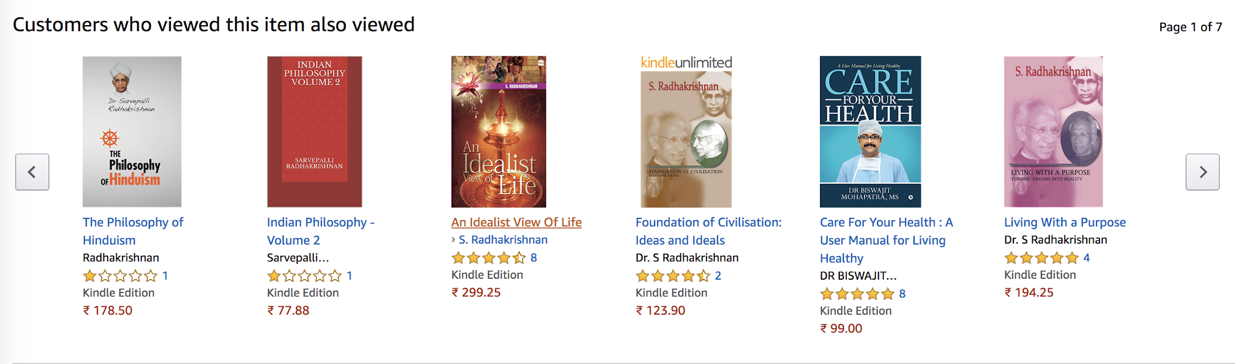
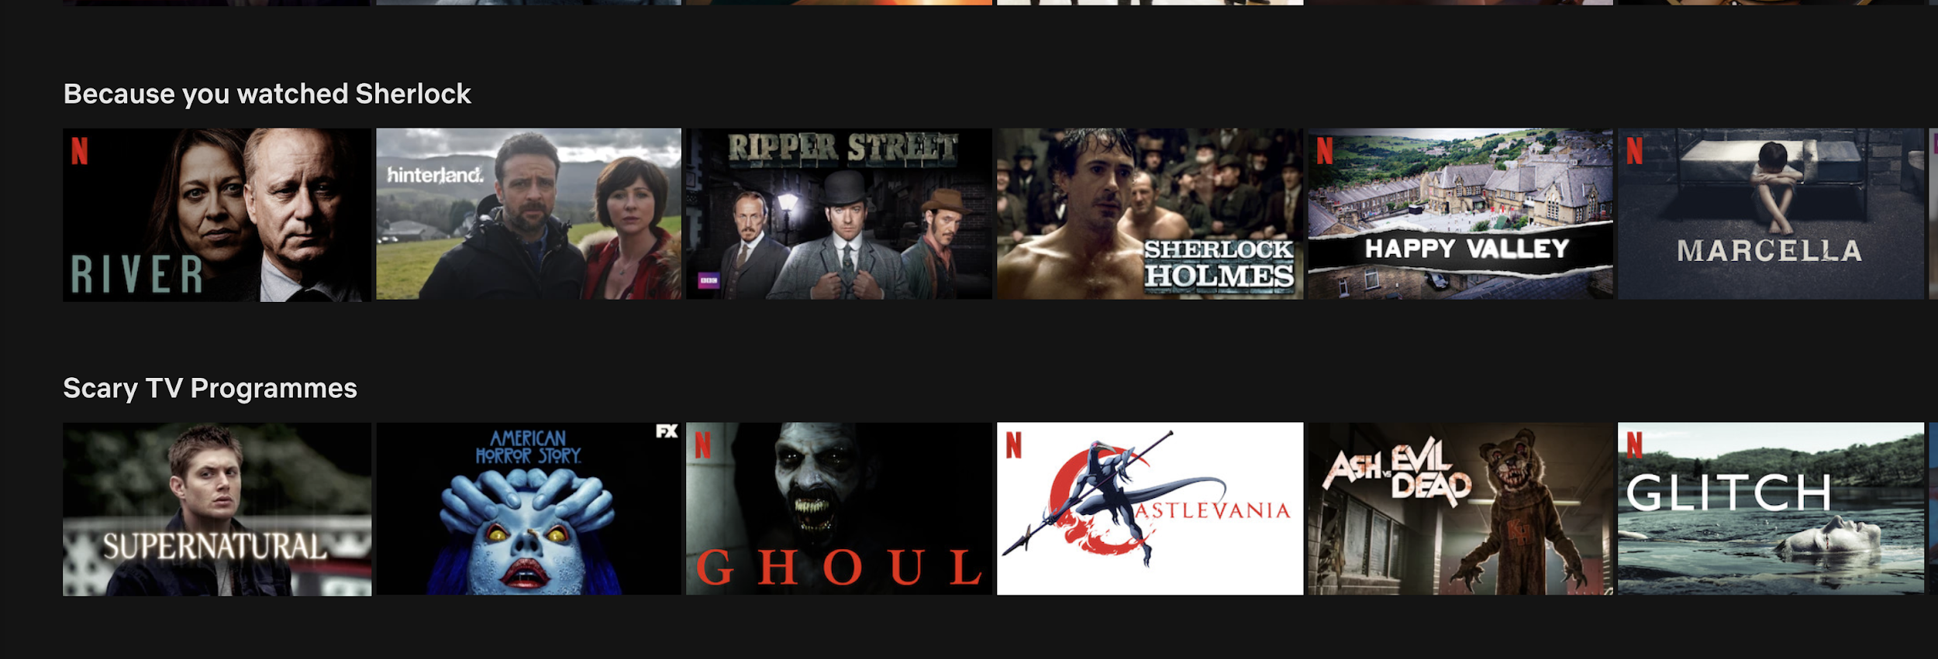

Slide 8
Algorithmic trading: Financial Markets
In algorithmic trading, machine learning helps to make better trading decisions.
Machine learning algorithms can analyze thousands of data sources simultaneously, something that human traders cannot possibly achieve.
Given the vast volumes of trading operations, that small advantage often translates into significant profits.
Why is the data required?

Slide 9
Social Network Analysis
Product Advertising
Personalized Recommendations
Understanding complex and hidden human patterns
Finding and busting terrorist networks.
Why is the data required?

Slide 10
So, what’s the problem?
When the data is readily available to you.
If you are part of a high-profile government funded research project.
If you or your research team has collaborations with world class labs that provide such data readily to you.
When do we NOT have a problem?

Slide 11
So, what’s the problem?
When the data is not available to you.
Usually, you do not have the required large-scale data to conduct your own independent research, (like me).
You would want to conduct some research in a completely diversified area but do not have the sanitised data for it (like me).
You want to compare state-of-the-art algorithms on new datasets being generated instead of referring to decade-old datasets (like me).
When do we have a problem?

Slide 12
Where is Data?
Dblp - co-authorship network
Textual data
Twitter
Facebook
Zomato
Stackoverflow
Blogs
SDSS
Everywhere you look! Structured/Unstructured form

Slide 13
Where is Data?
Some organizations/websites helpful.
API access (twitter)
Xml format (dblp)
Zip files (snap, kaggle)
Json format
FITS (Image Astronomical Data)
How to get it?

Slide 14
Static
&
Dynamic Websites
Static Websites
Easier to scrape/crawl.
No dynamic content helps in identifying the parts we need to crawl in a single HTTP request.
Examples

Slide 15
Static
&
Dynamic Websites
Dynamic Websites
Not so easy to scrape/crawl.
Needs to be monitored for parts which we require.
A more detailed analysis of the Request (using the Network tab in the browser).
Data that you require is dynamic in nature.
Examples

Slide 16
Diff B/W Webscraping & Webcrawling
Web scraping is a process of extracting data from websites. Scraper sends a GET query to a specific websites and then parses an HTML document based on the received, searches for the data that you have requested within that document and converts it into the specified format.
Web Crawling is collecting information about a website and links related to it. It also helps with HTML code validation and hyperlinks. Web crawler is also known as a Web Spider, automatic indexer or simply crawler.

Slide 17
Ethical Issues
Go over robots.txt first and understand what can/cannot be crawled.
Limit the speed of your program to avoid DDOS attacks.
Identify yourself/your scraper and be friendly.
Issues to keep in mind before starting your scraper.

Slide 18
Tools
Beautiful Soup is a Python library for getting data out of HTML, XML, and other markup languages.
Scrapy is a fast-high-level web crawling and web scraping framework, used to crawl websites and extract structured data from their pages.

Slide 19
Twitter API
https://developer.twitter.com/en/docs/tweets/filter-realtime/api-reference/post-statuses-filter.html
https://developer.twitter.com/en/docs/tweets/batch-historical/overview
https://developer.twitter.com/en/docs/basics/cursoring
Using readily available APIs

Slide 20
Twitter API
Streaming API
Data sent in near-real time
PUSH from Twitter
Persistent Connection needs to be open/long-lived
REST API
PULL from Twitter
Every HTTP Request is a new one
Past data can be queried
Analysis of the sentiment of tweets tweeted by Modi.
Notes:
What is it?
Real-time communication network.

Slide 21
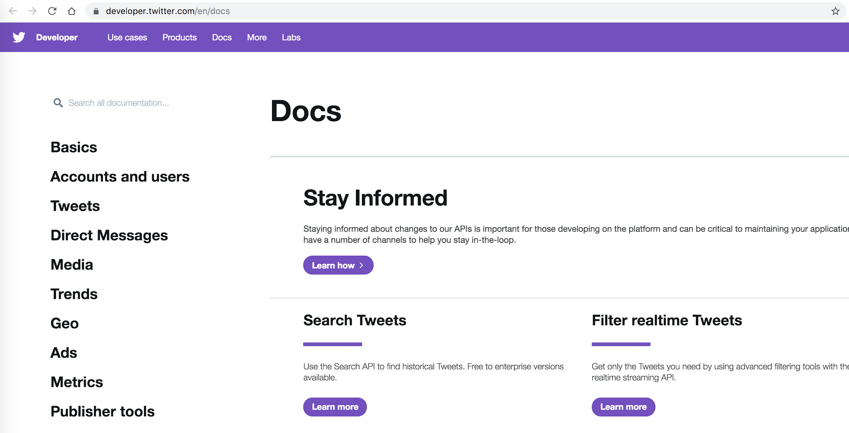
Twitter for developers

Slide 22
Twitter for developers: Things to consider
Why is the app required?
An App is a gateway to the Twitter Data.
Almost all data access needed, has to be through registering an App.
An App registration provides you with keys that is used in every HTTP Request.
Authentication
CONSUMER_API_KEY
CONSUMER_API_SECRET
ACCESS_TOKEN
ACCESS_TOKEN_SECRET
Rate Limits
Exponential Backoff
Status Code 402
Usage
tweepy (python) to start accessing Twitter Data

Slide 23
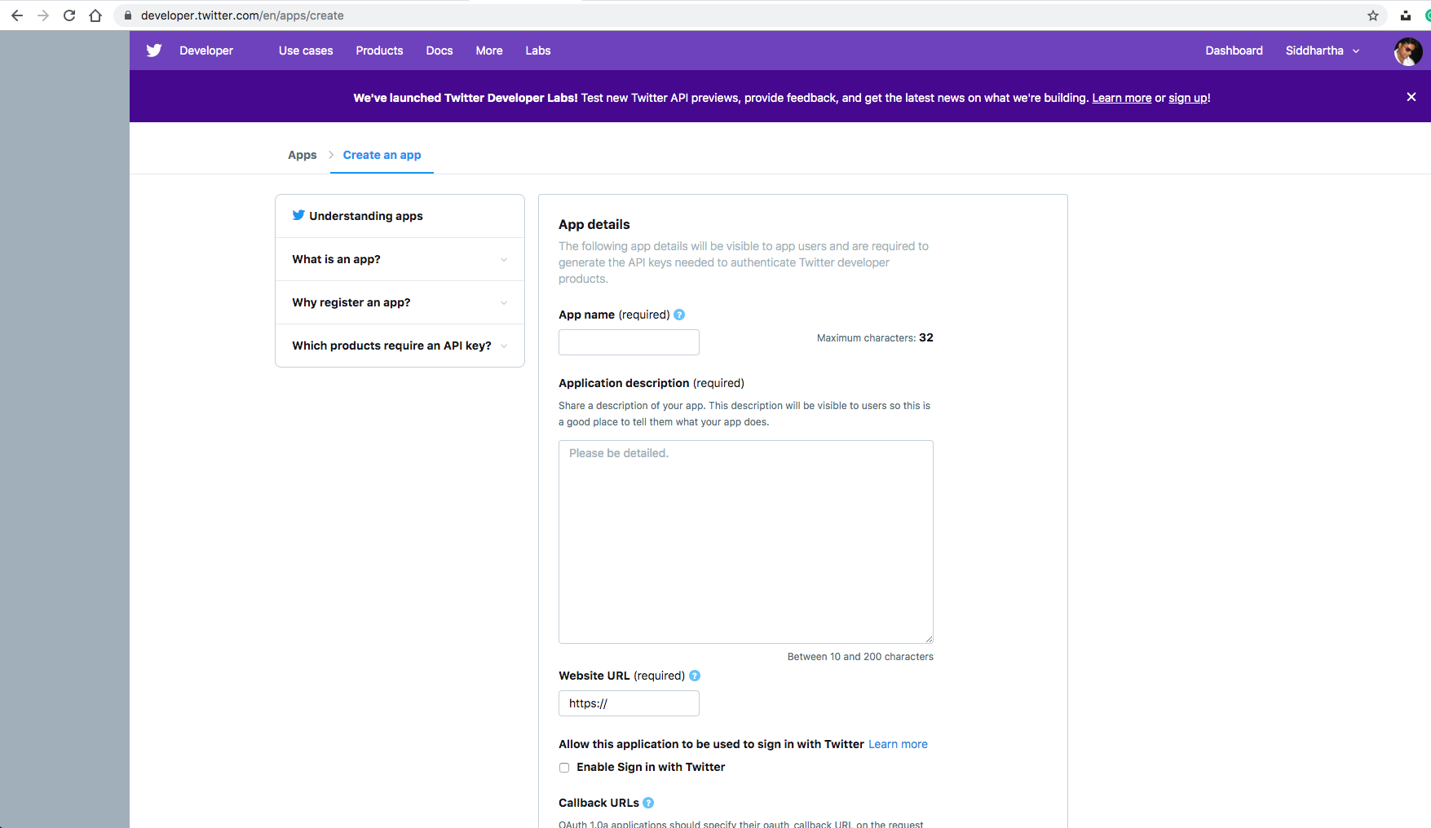
Twitter for developers: Registering your App

Slide 24
Co-authorship network
Go to /robots.txt
https://dblp.uni-trier.de/robots.txt
Understand what can/cannot be crawled.
Analyze the html content.
Use scrapy and bs4 to crawl.
Analyze the data!
Crawling dblp

Slide 25
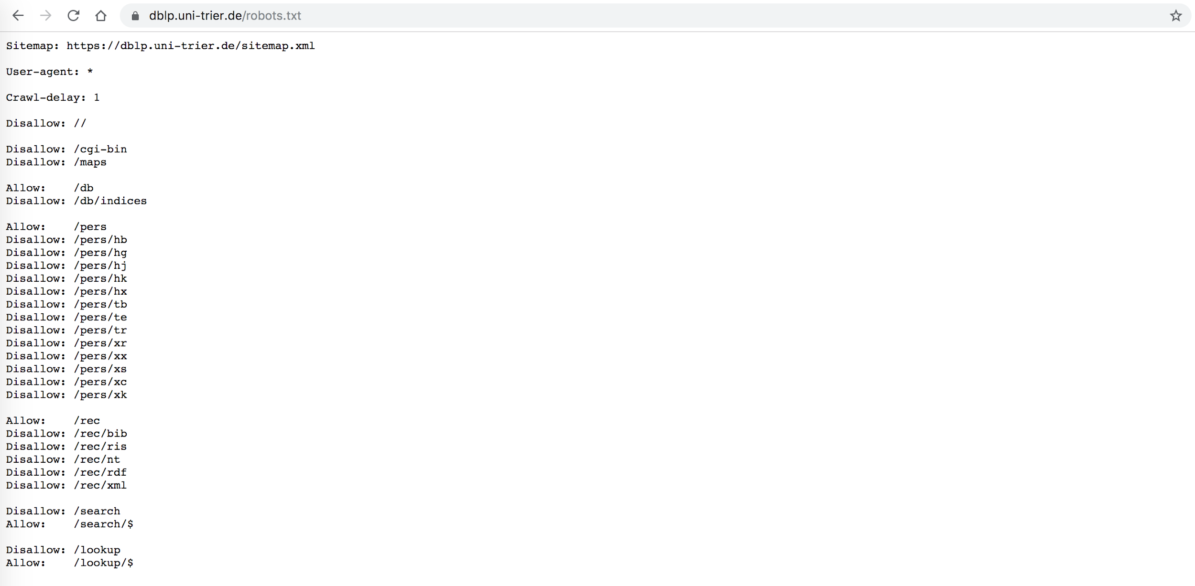
Dblp - robots.txt

Slide 26
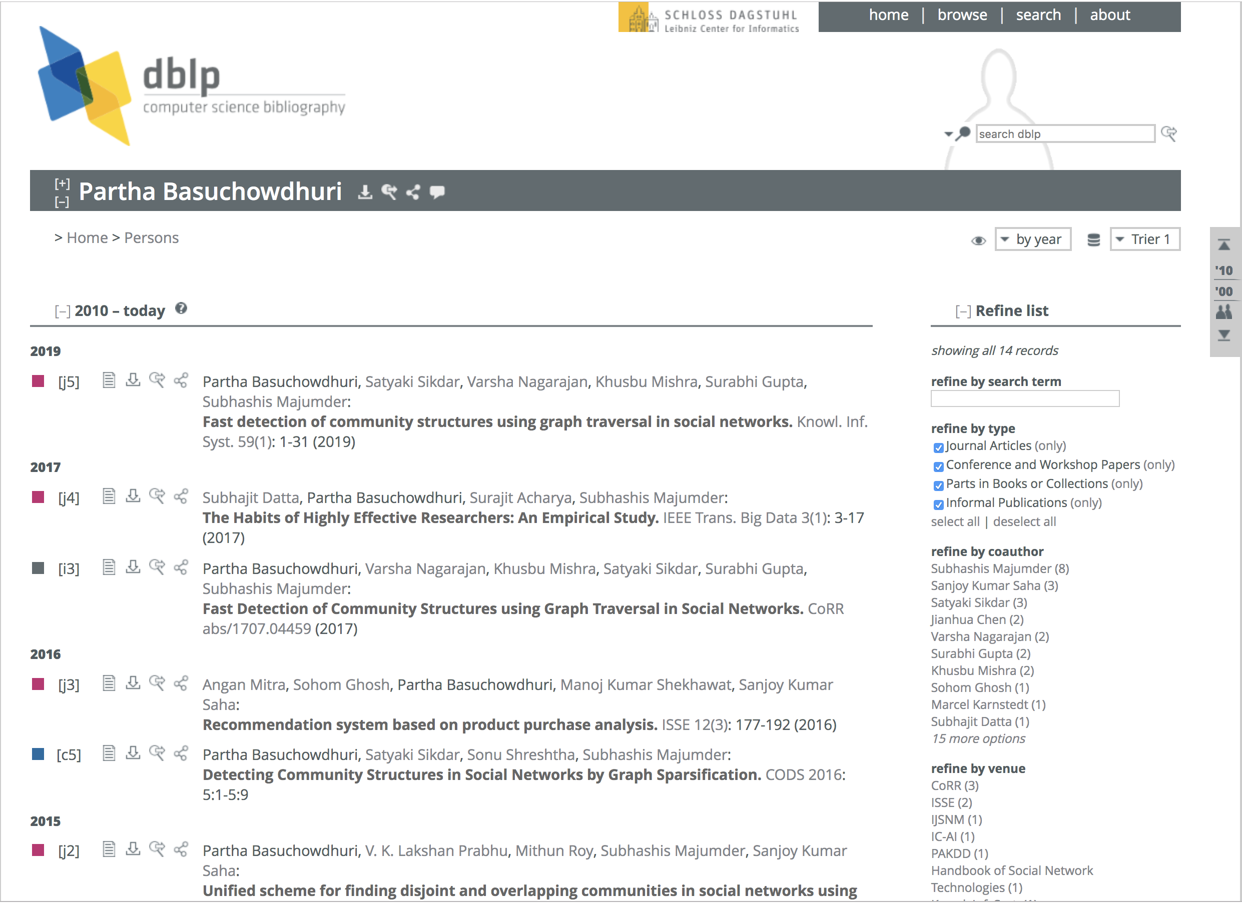
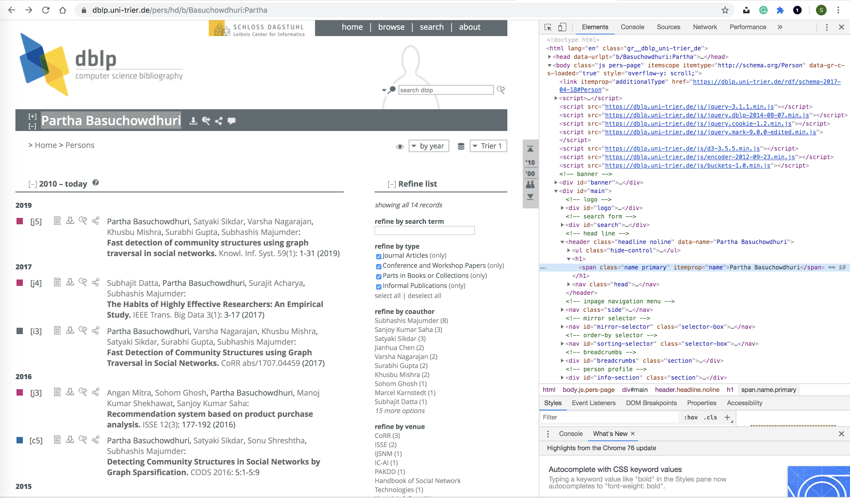
Dblp - Analyze the html

Slide 27
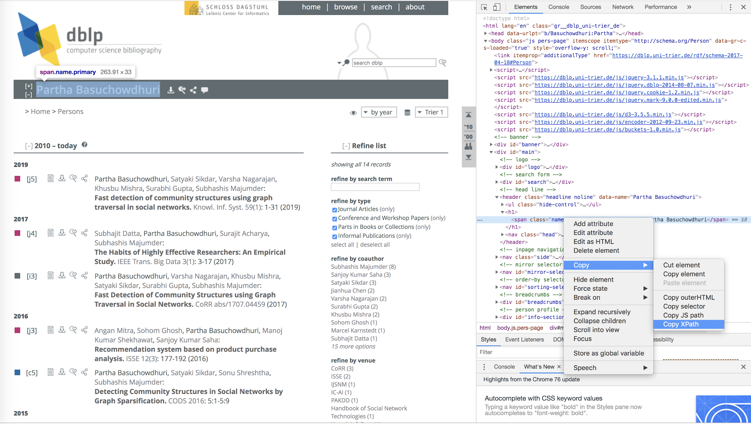
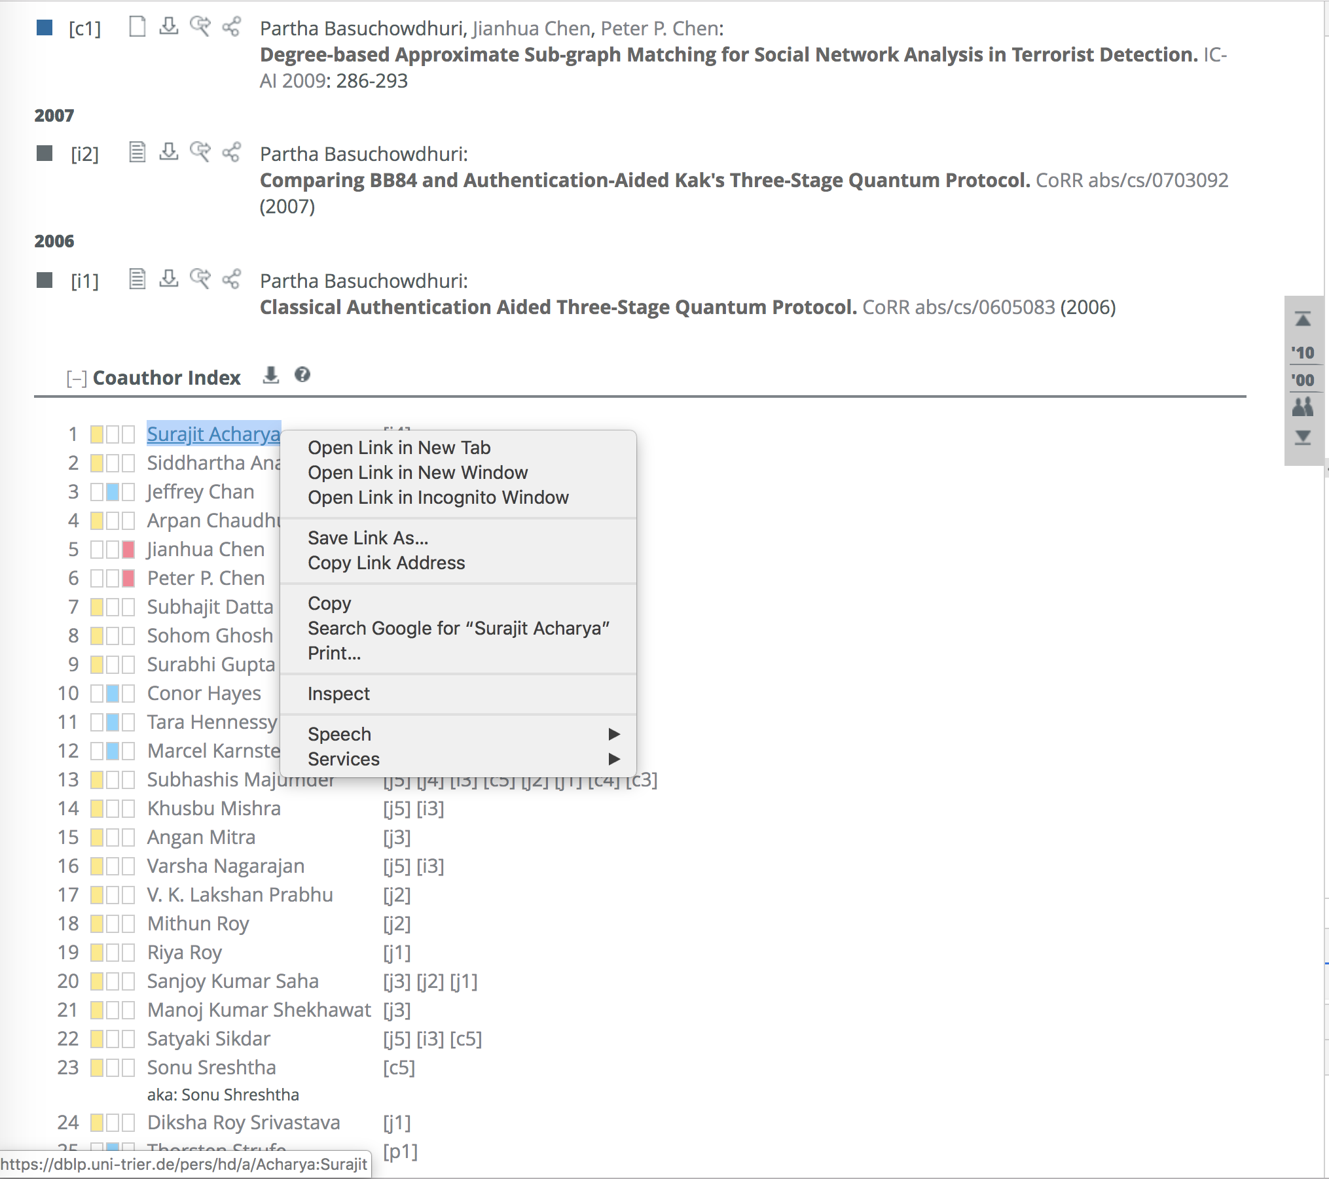
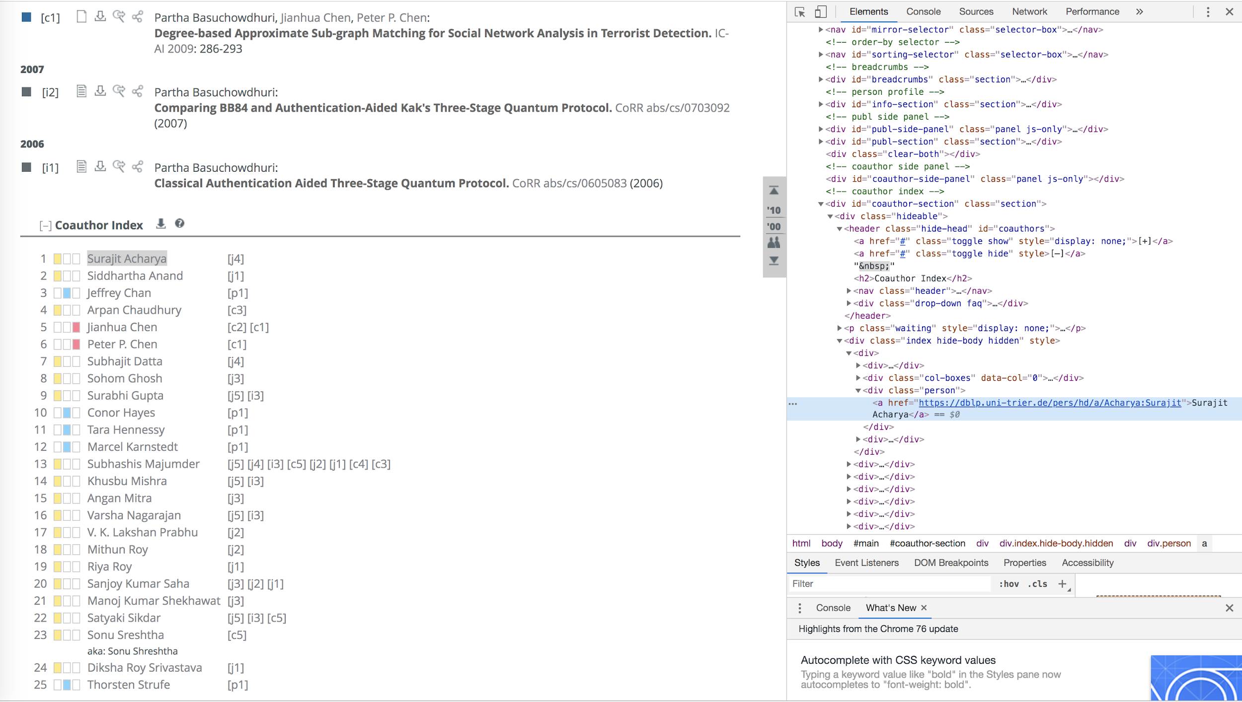
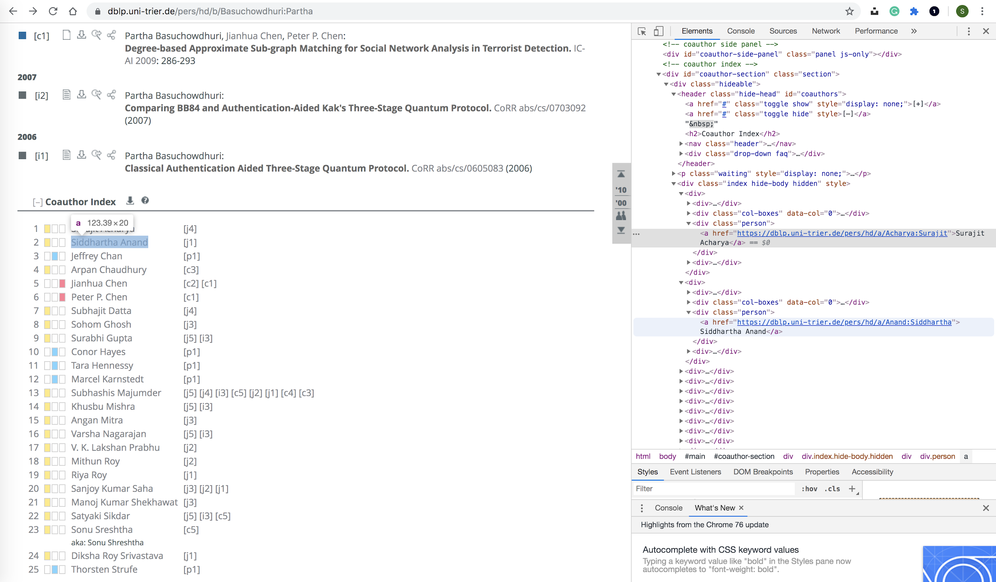
Dblp - Analyze the html

Slide 28
Imdb reviews
Problem definition: You need textual user reviews to train your machine learning model which can classify new reviews as Positive or Negative.
Data: Get data from imdb!
Data that you require is static in nature.
User reviews

Slide 29
Imdb reviews
Go to /robots.txt
https://www.imdb.com/robots.txt
Understand what can/cannot be crawled.
Analyze the html content.
Use scrapy and bs4 to crawl.
Analyze the data!
User reviews

Slide 30
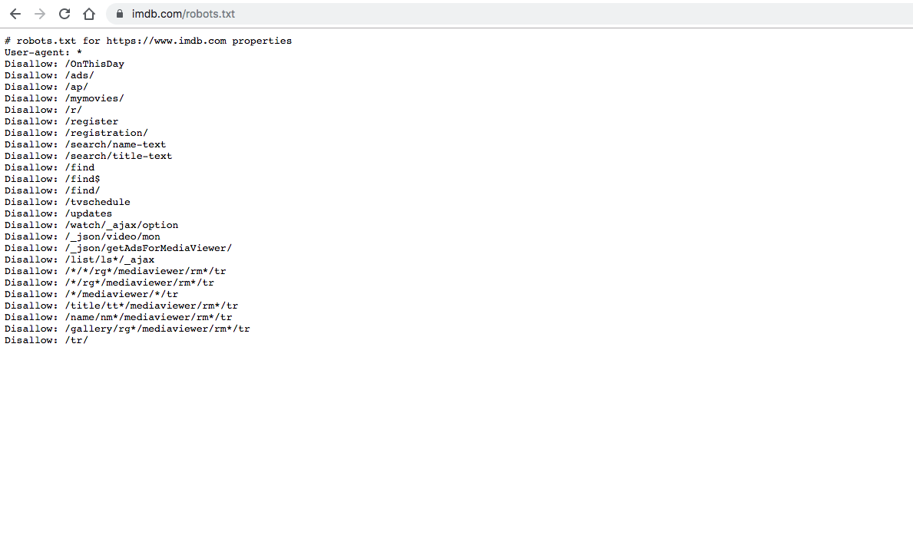
imdb - robots.txt

Slide 31
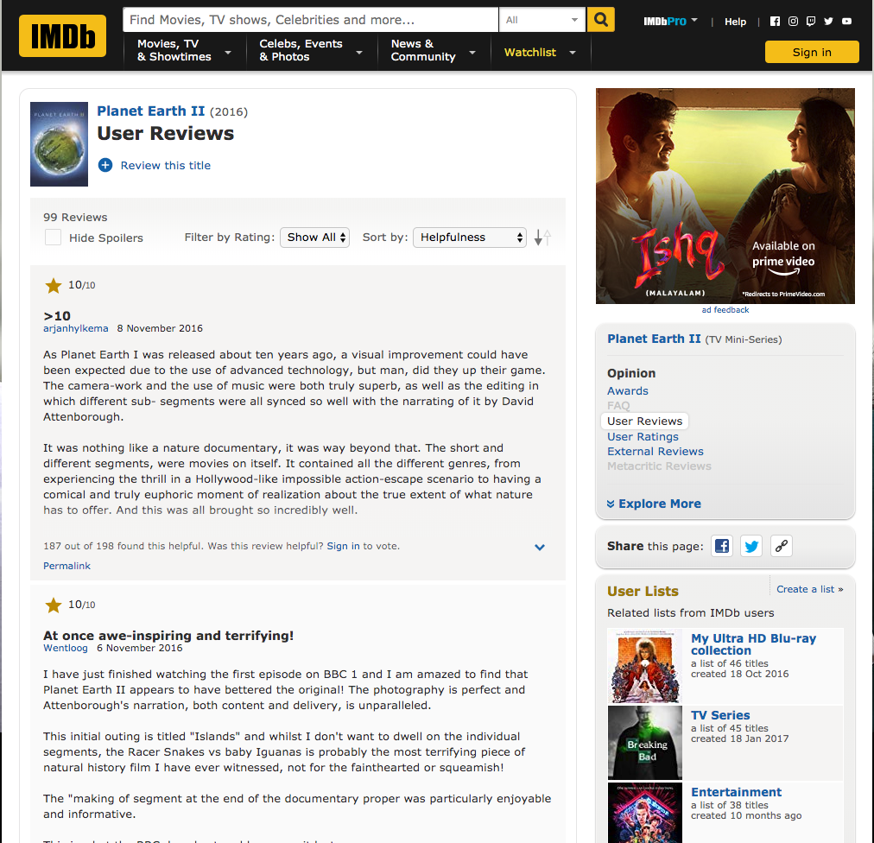
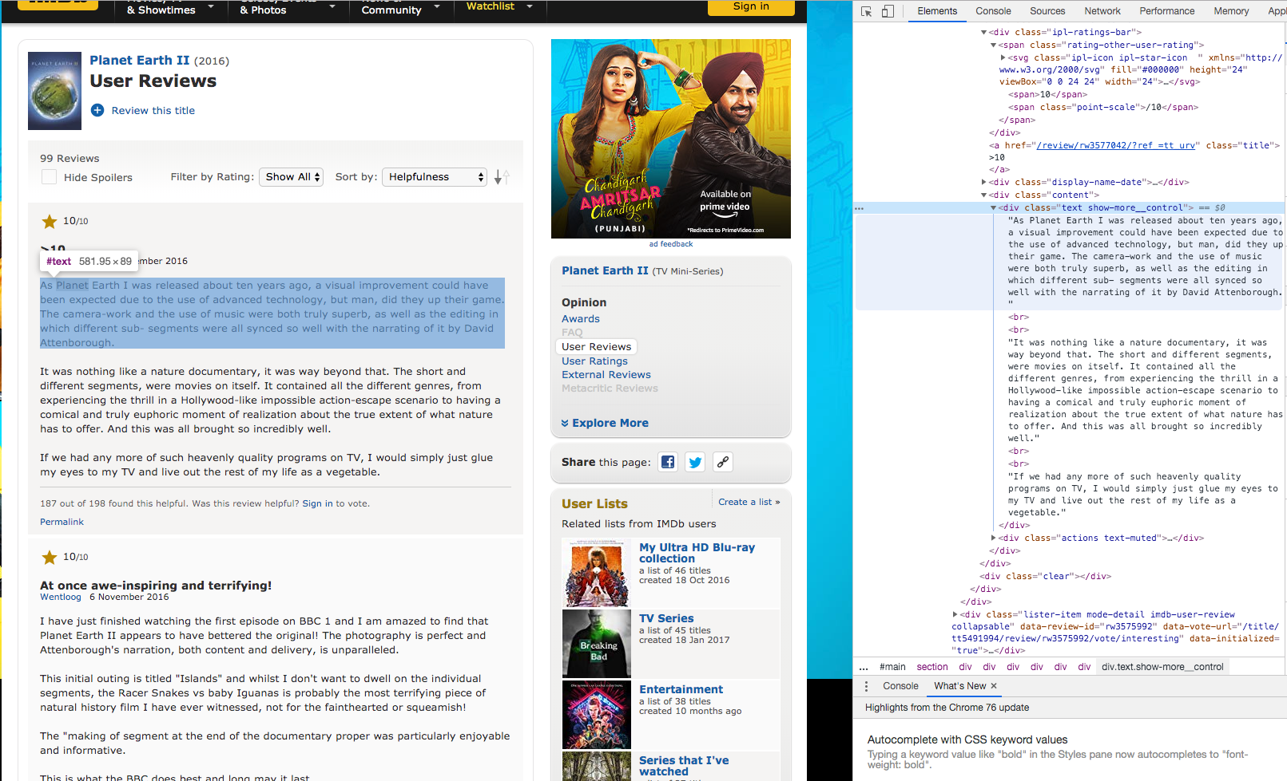
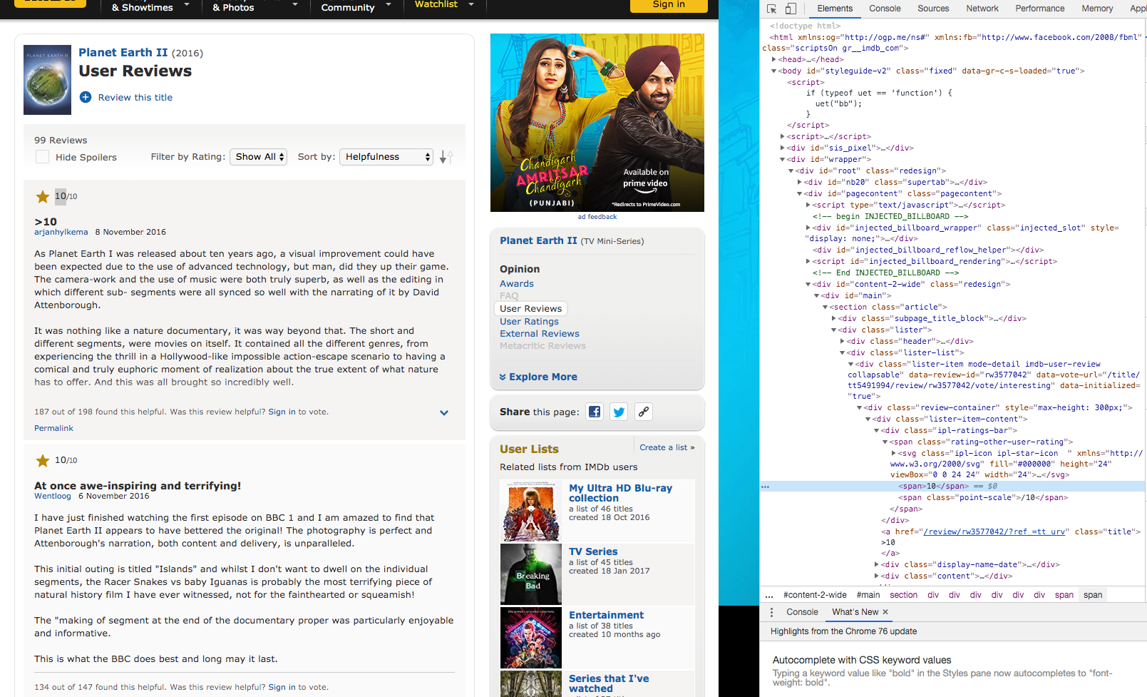
imdb - Analyze the html

Slide 32
Dynamic Websites
Problem: Predict the value of BTC for a future date using Machine Learning.
Data: Collect historical data from www.investing.com for training your model.
www.investing.com
Financial Data

Slide 33
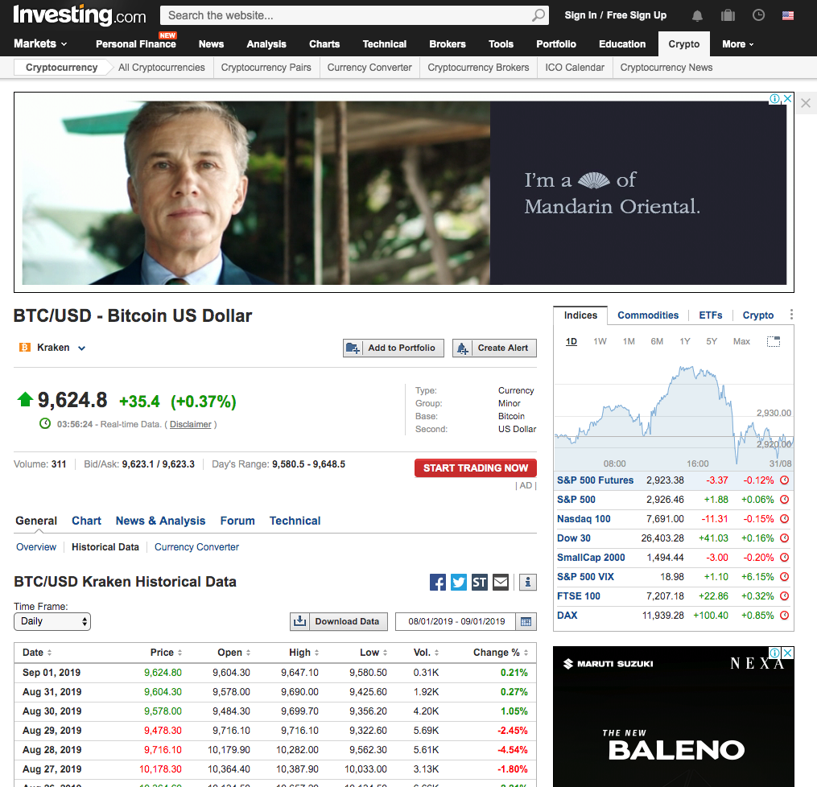
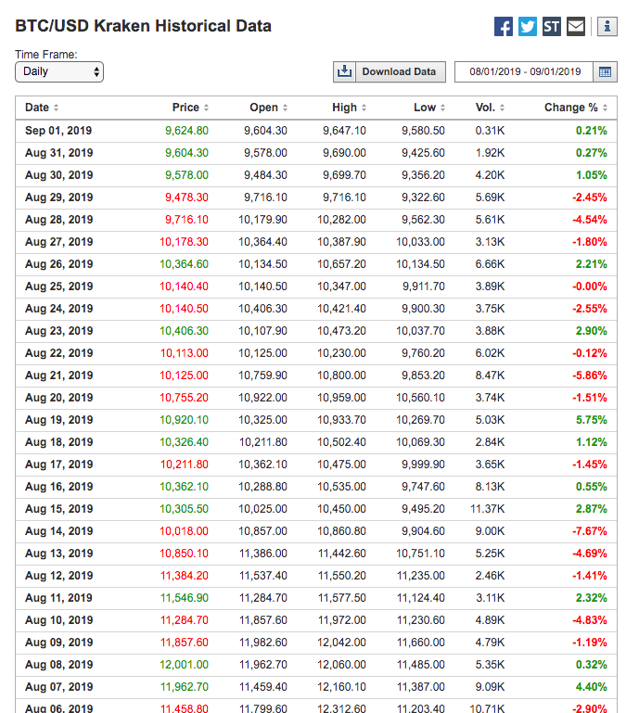
www.investing.com - Analyze the html

Slide 34
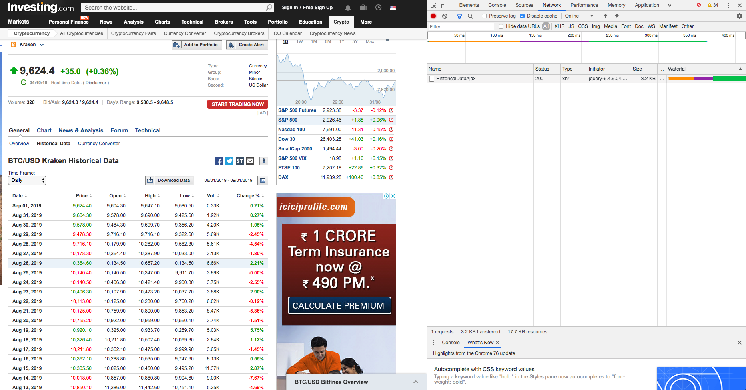
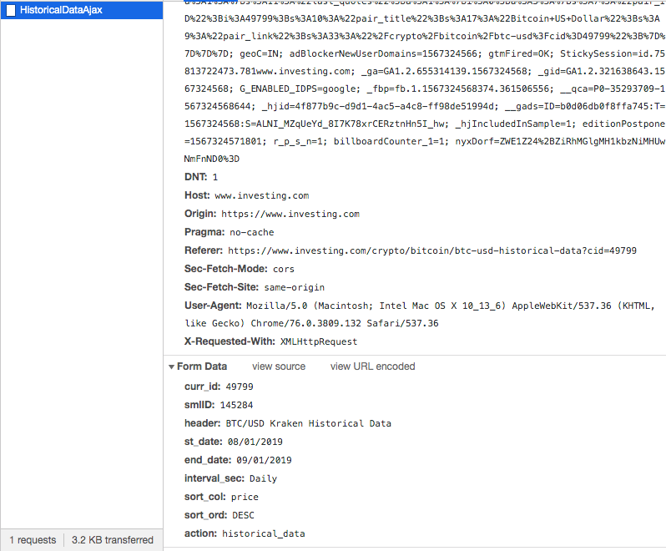
Analyzing Networks Tab

Slide 35
investing.com-Code
An amazing html/xml parser in python.
Analyzing the Networks tab gives us hints as to how to proceed further.
Replicate a Request same as the one by the browser.

Slide 36
Already available data-stores
snap.stanford.edu
Kaggle
Sometimes you might get exactly what you need.

Slide 37
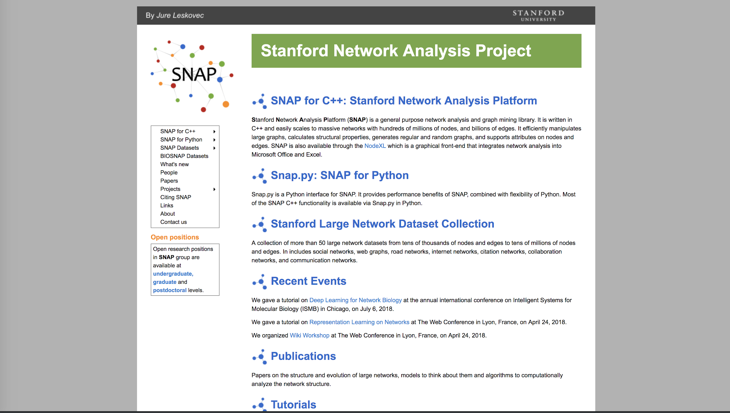

Slide 38
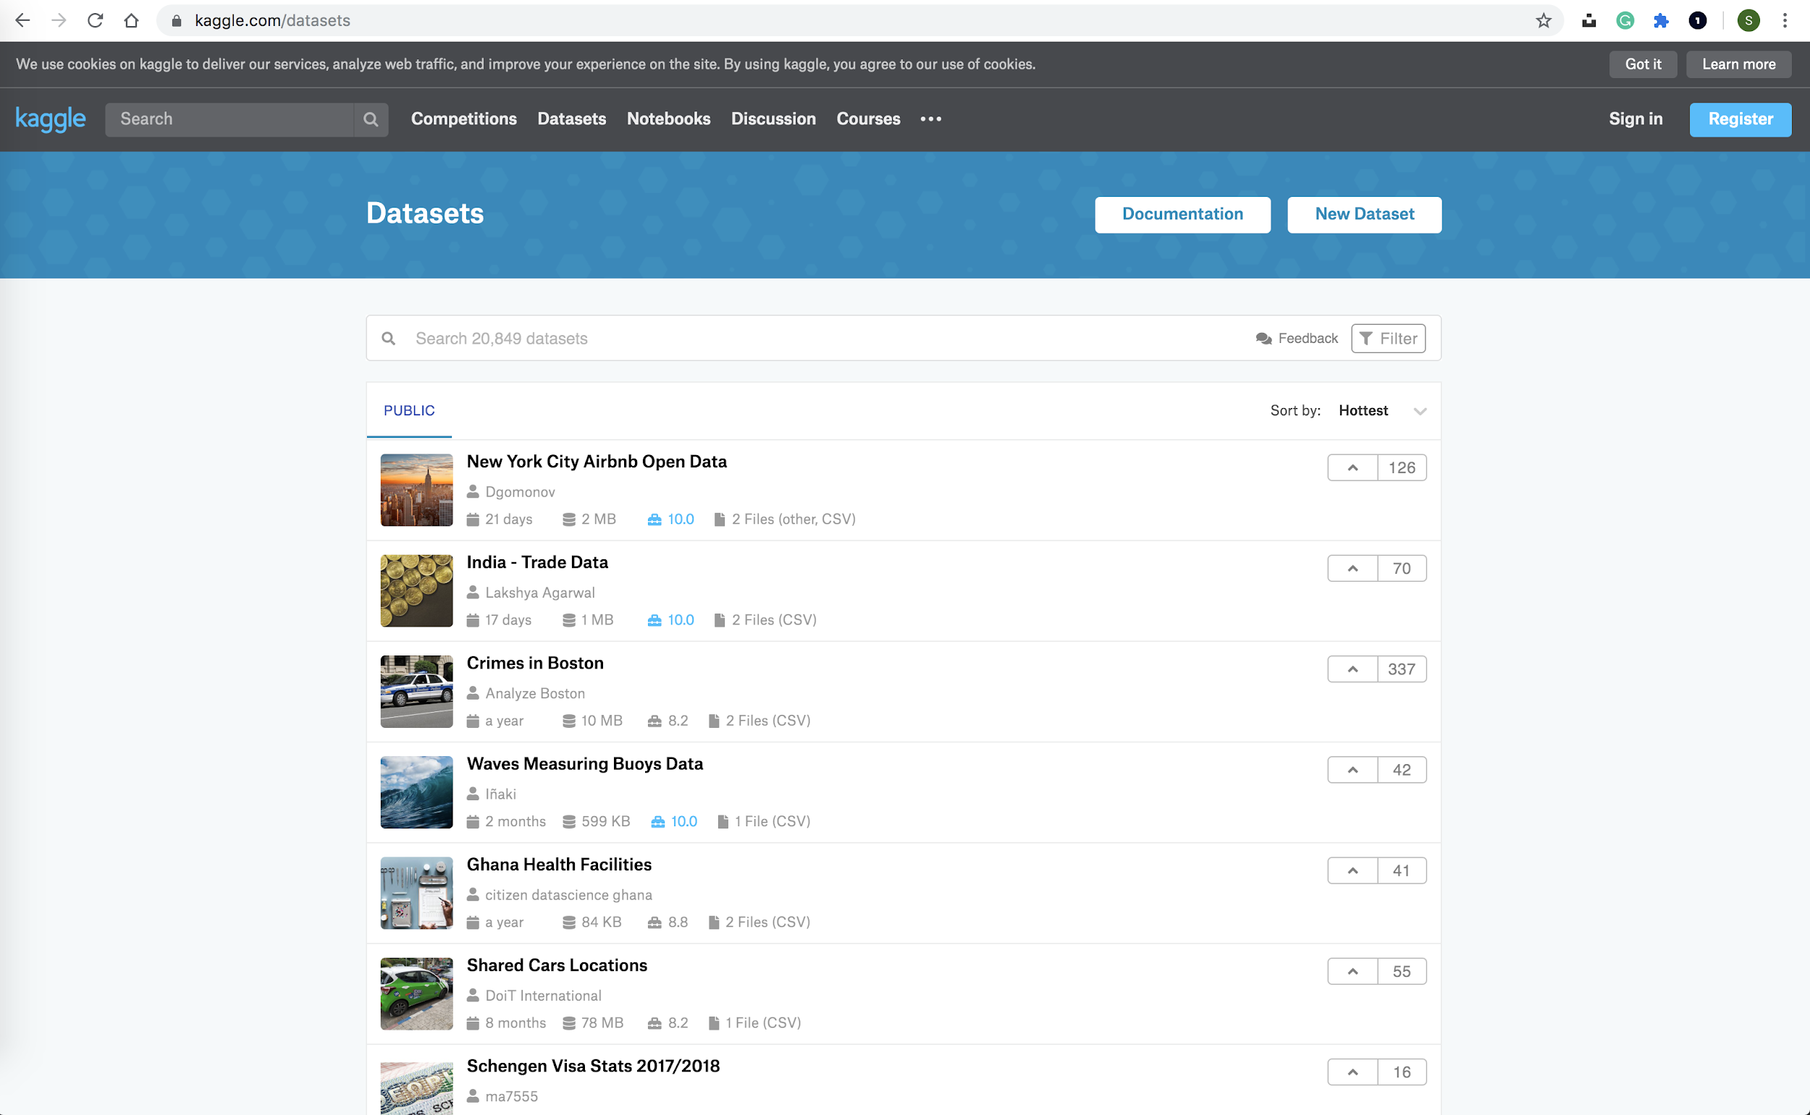
kaggle

Slide 39
Q/A?

